Slide 1
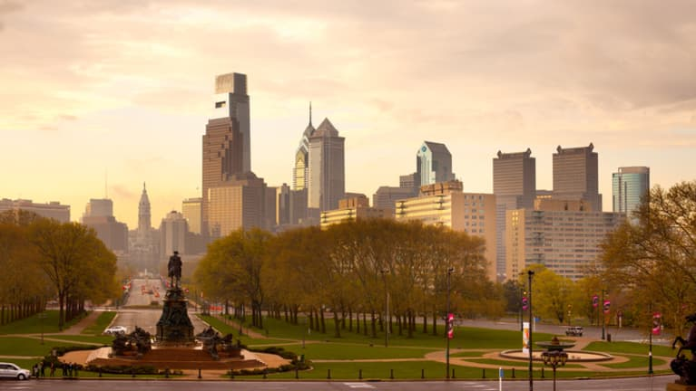
Crimes in Philadelphia
Raj Patel, Hong Son, Kunal Sharma
Notes:
Raj

Slide 2

Agenda
Team Introduction
Problem Statement
Target Audience
Github
Datasets
Visualizations & Interpretations
Statistical Analysis
Machine Learning
Suggestions/Recommendations
Limitations
Future Work
Work Cited
Questions

Slide 3



Team
Hong Son
Education: BS/MS Data Science Drexel University (in-progress)
Occupation: Student
Skills: Data engineering, machine learning, and presenting.
Kunal Sharma
Education: MS Data Science Drexel University (in-progress)
Occupation: Student
Skills: Data engineering, machine learning
Raj Patel
Education: BS/MS Data Science Drexel University (in-progress)
Occupation: Student
Skills: Data cleansing, statistical analysis, and documentation.
Notes:
Each person introduces each other

Slide 4



Problem Statement
Philadelphia ranks above the national average in terms of crimes (especially violent crimes)
Ranks second in murder rates among the 10 largest cities in 2020
It has been included in real estate analytics company NeighborhoodScout's "Top 100 Most Dangerous Cities in America" list every year since it has been compiled
Are there any overarching themes related to crime in Philadelphia that can help predict the likelihood of a crime on Philadelphia?
Notes:
Raj
https://6abc.com/philadelphia-crime-homicide-stats-philly-murders/6351850/

Slide 5
Intended Audience
Law Enforcement Officials (Philadelphia Police Department)
Equip law enforcement with intelligence to effectively combat crime proactively
City Officials
Help officials identify areas and allocate resources to monitor crime
Citizens
Educate citizens about the crimes happening in Philadelphia
Notes:
Raj

Slide 6

Github
Folder Structure
https://github.com/hongson1218/Crime-in-Philadelphia
Crime
Presentations
Reports
Weather
Notes:
Hong

Slide 7


Datasets
Philadelphia Crime Data:
Published by OpenPhillyData
Dates from 12-31-05 to 03-22-17 (majority of the dates are from 2006-2016)
Attributes include the district number, sector, dispatch date, dispatch time, location, general code, descriptions of the crime, and the district
There are 14 total columns and ~2,237,605 in this dataset.
Philadelphia Weather Data:
Published by Pennsylvania State Climatologist
Dates from 2007 to 2018
The dataset includes the temperatures in Fahrenheit, the max and min temperature, environment information, wind, and precipitation.
The data was formatted from PDF files and a dataset was formed [~4,000 rows and 14 columns].
Notes:
Hong

Slide 8
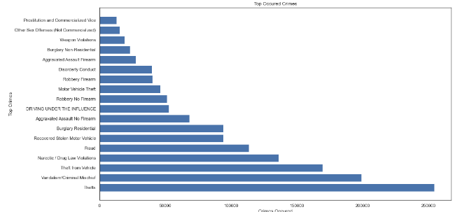
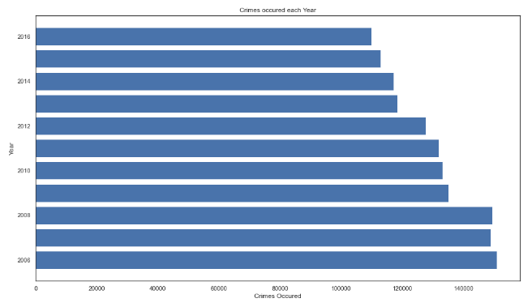
Top Crimes & Number of Crimes (10 years)
The top 5 kinds of crimes being Theft, Vandalism/Criminal Mischief, Theft from Vehicle, Narcotic / Drug Law Violations and Fraud.
The graph above shows the total number of crimes that have occurred each year in the past from our dataset. We found that the number of crimes occured in the past years have declined.
Notes:
Kunal

Slide 9
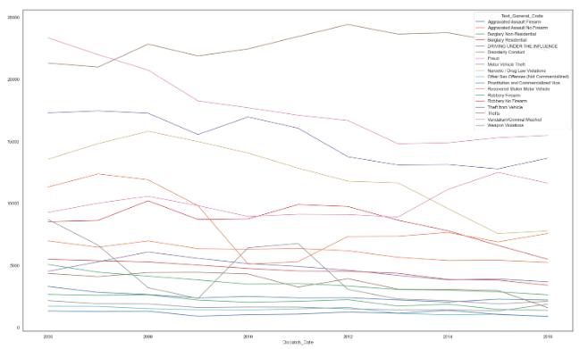
Types of Crimes that Occured (10 years)
The graph on the left shows the top crimes in philadelphia and the total number of times it has occurred in the past years from the data set. We found that crimes that have inclined in numbers of occurrence like Thefts, frauds etc and the crimes that declined in numbers of occurrence like criminal mischief and motor vehicle theft.
Notes:
Kunal

Slide 10
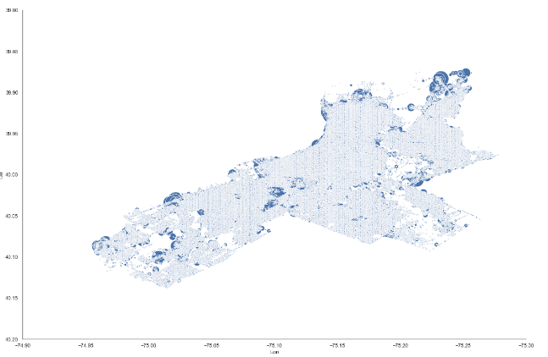
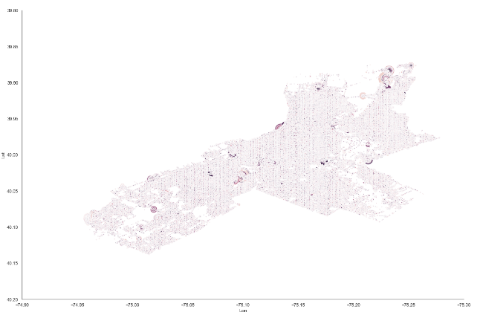
Heatmap of Regions with most crimes
We found that crimes have occurred throughout Philadelphia in the past however, the larger blobs in the graph above like the ones we see in northern Philadelphia are the locations where the crimes have occured the most.
Notes:
Hong

Slide 11
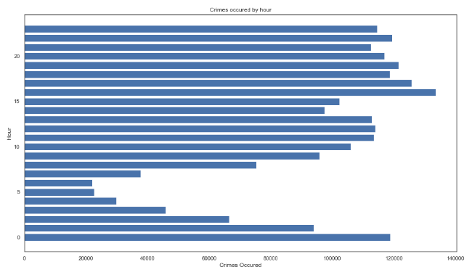
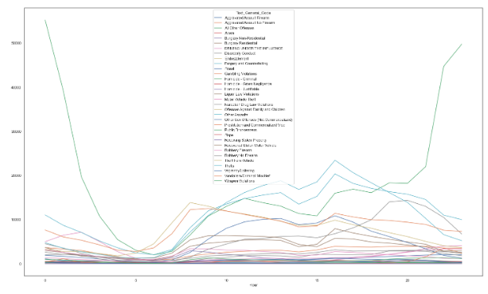
Number of Crimes by Hours
The graph above shows different types of crime that have most occured in Philadelphia by the hour in the past years from our dataset. We see a similar pattern for most of the top crimes. We found that the least number of crimes that have occured in the past is between 3am-6am and after that the numbers go up for every crime.
The graph above shows the occurrence of crime by the hour in the past years from our dataset. We found that the least number of the crimes that have occured in the past is between 3am-6am and after that the numbers go up and are at its peak at 4pm.
Notes:
Hong

Slide 12
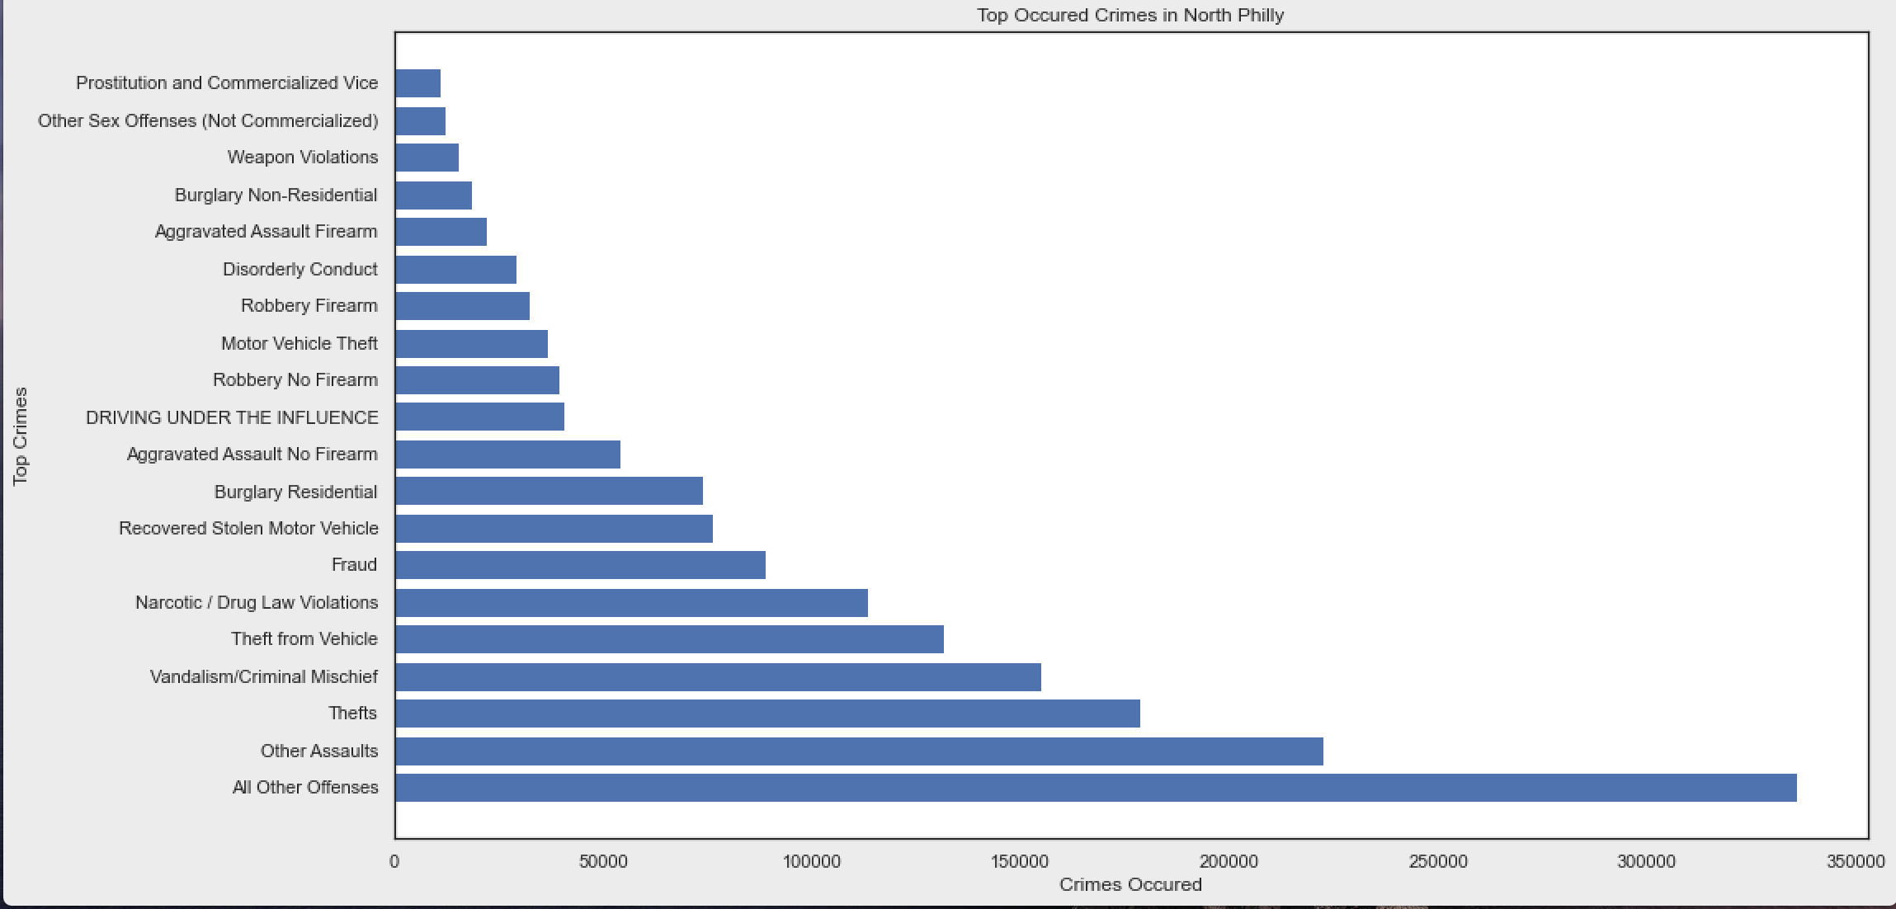
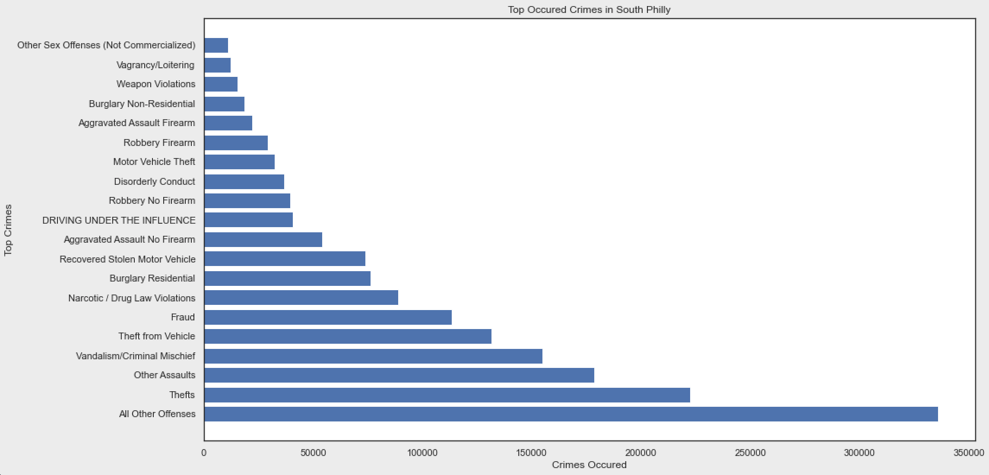
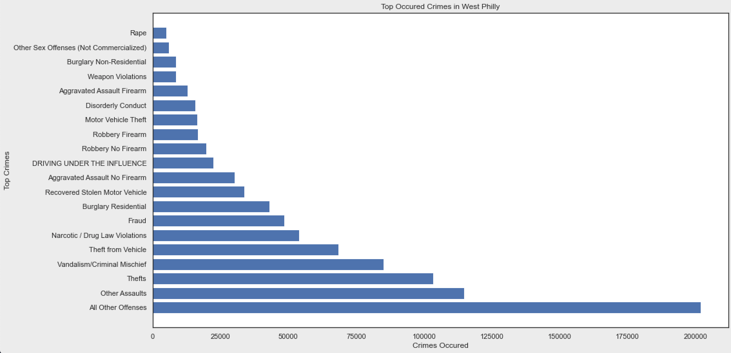
Looking at Number of Crimes by Regions
We found similar pattern in the crimes that have occured in all three region
Notes:
Hong

Slide 13
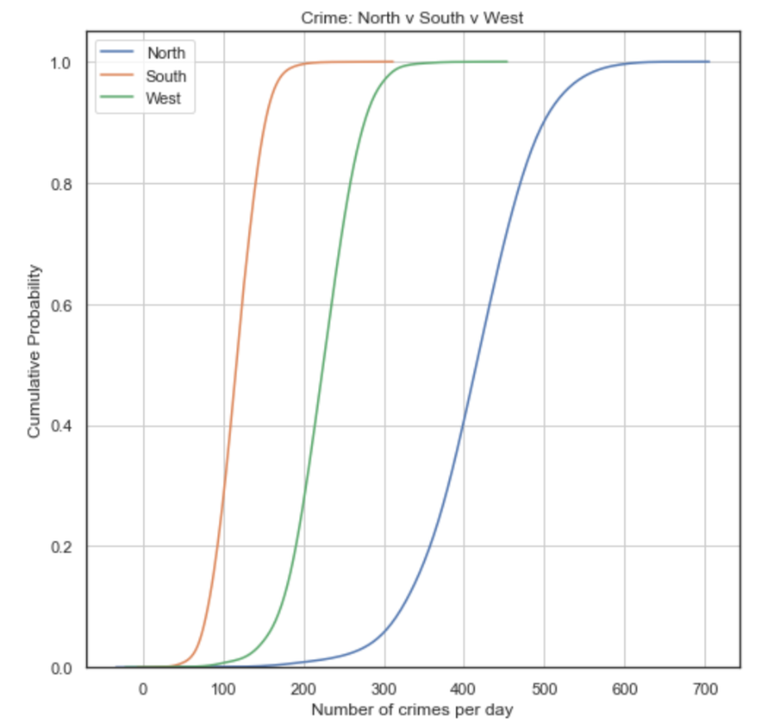
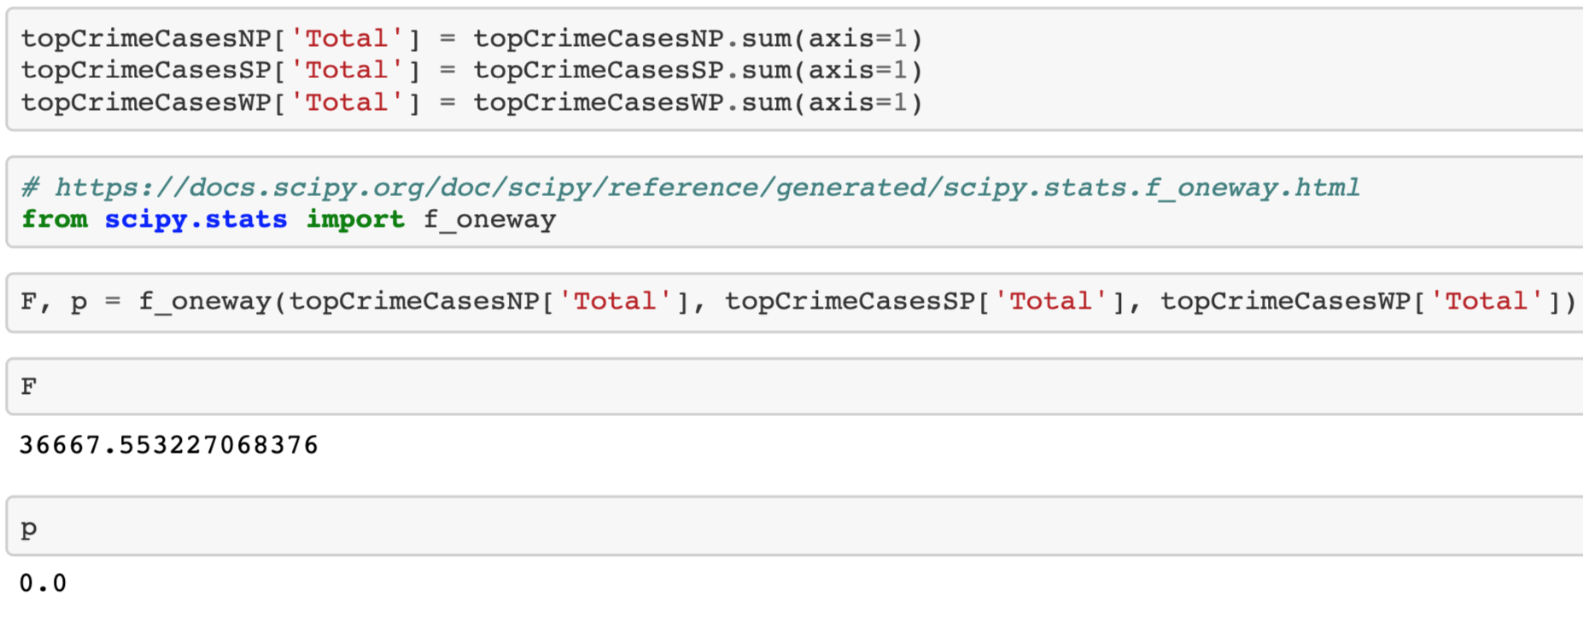
Anova
CDF Plot
H(o): Average crime count is the same across regions (north, west, south)
H(a): Average crime count is not the same across regions (north, west, south)
Alpha value: 0.05
P = 0
Reject null hypothesis
Statistically significant
Average crime counts are not the same across regions
Notes:
Raj

Slide 14
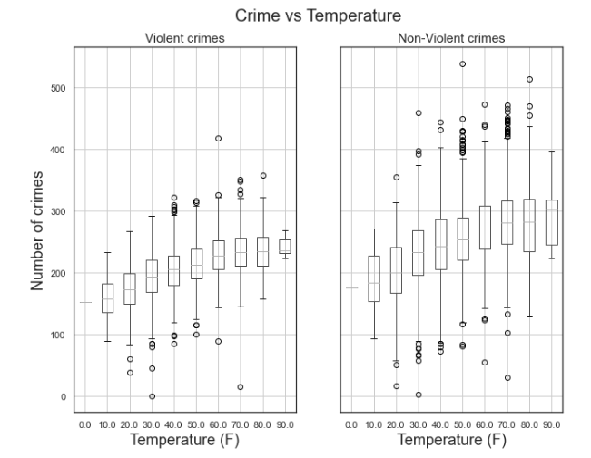
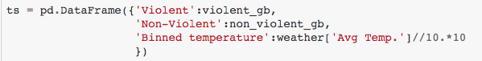
Temperature and Number of Crimes
The mean of the crimes is increasing with temperature. Seasonal changes can affect the crime rate (crimes are high during summer season - we will confirm in Seasonal Analysis).
Notes:
Raj

Slide 15
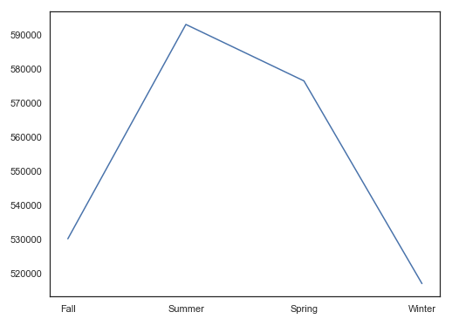
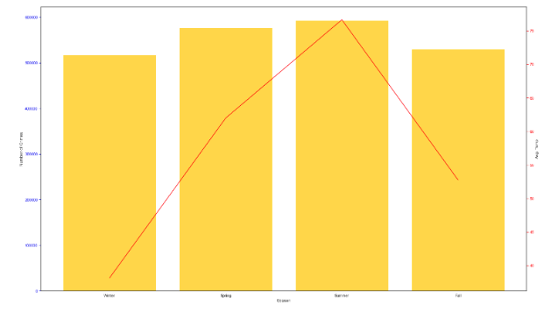
Number of Crimes by Seasons
We see that the number of crimes is the most in the Summer, followed by the Spring, Spring, and then Winter. We see that the trend in temperature can be seen in the seasons.
Notes:
Raj

Slide 16
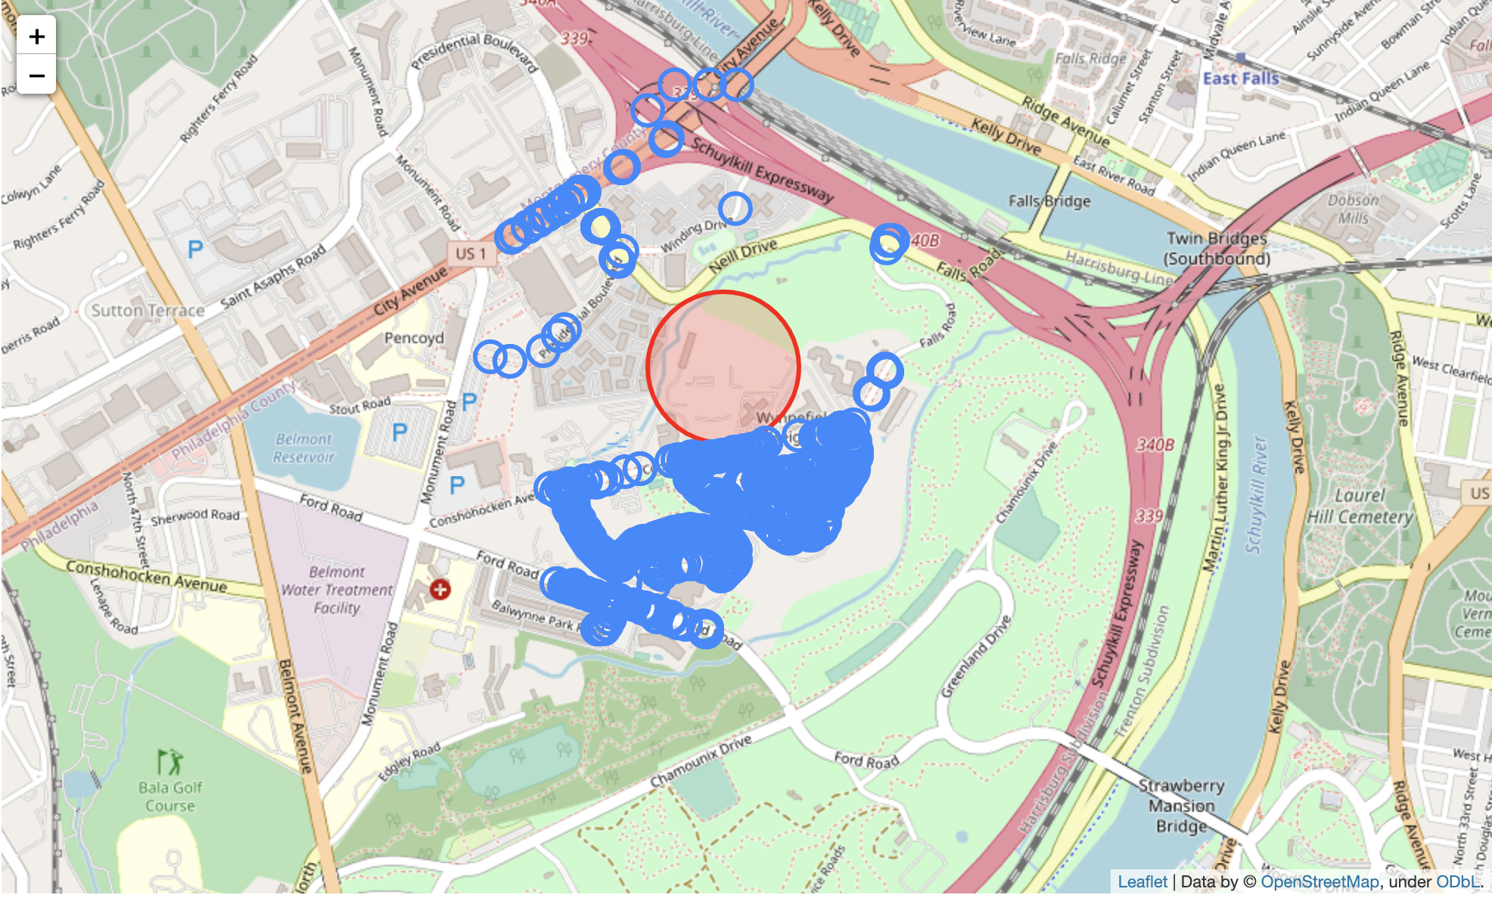
Machine Learning
Probability that a crime occur given a user specified location and day of the year
We are using Google’s cloud API to gain the geolocations of any user specified location within Philadelphia in real time.
Since philadelphia has over 500,000 different points of Geo-locations
We considered the 500 nearest locations in the crime dataset using k nearest neighbor from sklearn
The above image contains the location that we focused on with a red marker and the nearest 500 different locations where crimes have occured in the past years from our dataset.
Notes:
Kunal

Slide 17
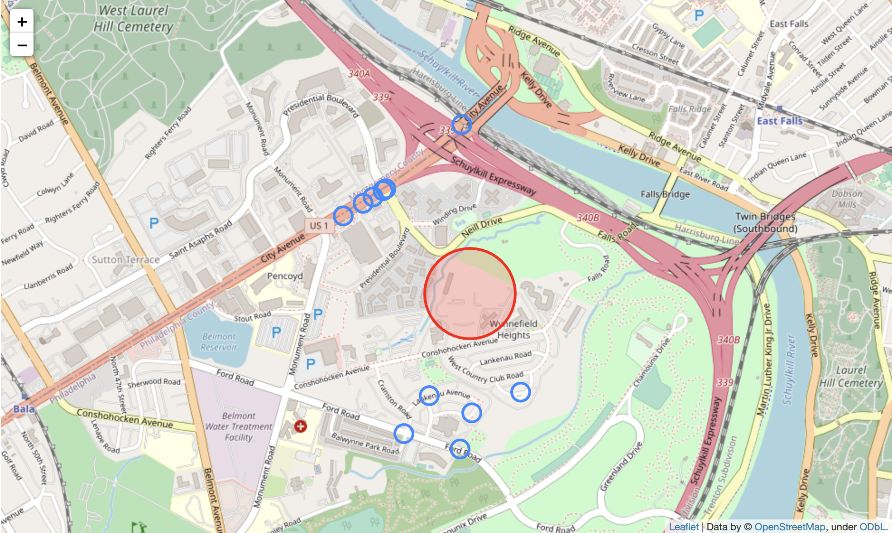
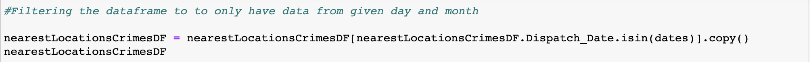
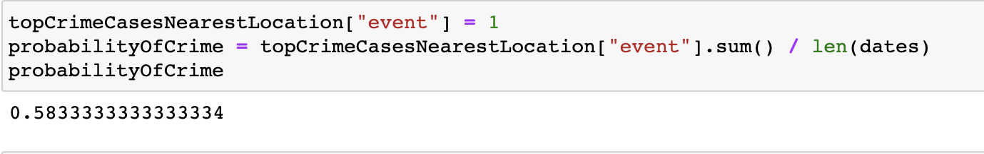
Machine Learning (Cont.)
Since we want to focus only on the user specified day of the year, we filtered our dataset to have only the day (eg: Nov 11th) for each year in the dataset that we are using and the nearest locations from above.
Finally, to gain a probability that a crime will occur on a user specified data and location we get the total number of years when a crime has occured in our dataset and divide it with the total number of years from the dataset.
The image above contains only the nearest locations where the crimes have occurred on a user specified date (Nov 11th in this case). In the filtered data frame above based on user specified day and location, we have also achieved essential data about the weather, wind speed, type of crime (violent or non-violent).
Notes:
Kunal

Slide 18
Suggestions/Recommendations
•Increase police enforcement trainings on Theft, Vandalism/Criminal Mischief, Theft from Vehicle, Narcotic / Drug Law Violations and Fraud.
•Deploy more police enforcement in North Philadelphia
•Increase the number of police officers on duty during the day and night and decrease the number of officers on duty from 3 am - 6 am
•Staff a larger number of officer in the warmer months than colder ones
Notes:
Raj

Slide 19
Limitations
Weather dataset did not keep track of snow days
Crime Data set is not up to date (2006-2017).
Weather dataset is not up to date (2007-2018).
Notes:
Kunal

Slide 20
Future Work
Predicting the number of different crimes in Philadelphia (ex. Theft)
Look for weather dataset that has snow depth
Comparing different cities and their policies
Integrate More datasets
Community Health Assessment Dataset
Housing prices
Health and property Insurance
Average Income
Unemployment rates each year.
Population and diversity.
Create a Medium article
Notes:
Kunal

Slide 21
Work Cited
Chirico, M. (2016). Philadelphia Crime Data. Retrieved 2020, from https://www.kaggle.com/mchirico/philadelphiacrimedata.
Cuellar, D. (2020, August 04). Philadelphia Among Top Deadliest Cities in U.S. This Year. Retrieved November, 2020, from 12345https://6abc.com/philadelphia-crime-homicide-stats-philly-murders/6351850/
Neighborhood Scout's Most Dangerous Cities - 2020. (2020, January 22). Retrieved November, 2020, from 11111https://www.neighborhoodscout.com/blog/top100dangerous
The Pennsylvania State Climatologist. (2020). Retrieved 2020, from 11111http://www.climate.psu.edu/data/city_information/index.php?city=phl&page=dwa&type=big7
Notes:
Raj

Slide 22

Questions?

